Slide 1
Unit 5

Slide 2
Outline
Reading Summary
Definition
Formulas
Additional Resources

Slide 3
Summary
A sample space is the set of all the values the measurement may potentially obtain
For the distribution of a random variable, the center location is called expectation and the spread is measured by the variance and standard deviation (for the distribution of the data, the center location is called mean, while the spread is measured by the variance and standard deviation)
A Discrete random variable is a random variable for which the values in the sample space are separated from each other, say the values are integers

Slide 4
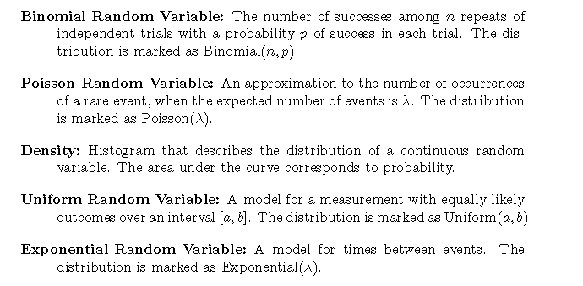
Definition

Slide 5
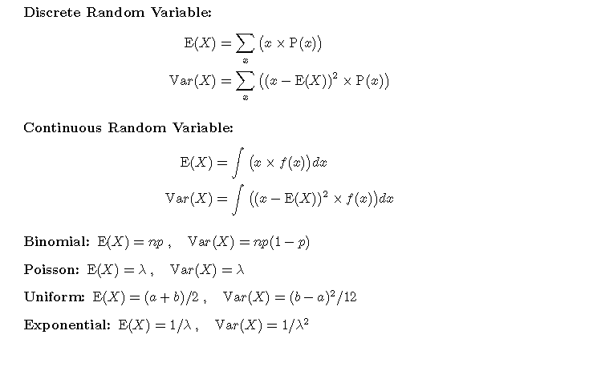
Formulas

Slide 6
Additional Resources
Discrete random variable: https://www.khanacademy.org/math/statistics-probability/random-variables-stats-library/random-variables-discrete/v/random-variables
Continuous random variable: https://www.khanacademy.org/math/statistics-probability/random-variables-stats-library/random-variables-continuous/v/probability-density-functions

Slide 7
Additional Resources
Binomial Distribution: https://www.khanacademy.org/math/statistics-probability/random-variables-stats-library/binomial-random-variables/v/binomial-variables
https://www.khanacademy.org/math/statistics-probability/random-variables-stats-library/binomial-mean-standard-dev-formulas/v/mean-and-variance-of-bernoulli-distribution-example
Poisson Distribution: https://www.khanacademy.org/math/statistics-probability/random-variables-stats-library/poisson-distribution/v/poisson-process-1
https://www.youtube.com/watch?v=jmqZG6roVqU

Slide 8
Additional Resources
Uniform random variable:
https://www.youtube.com/watch?v=izE1dXrH5JA
Exponential random variable:
https://www.youtube.com/watch?v=bKkLYSi5XNE
Density Function and Probability distribution:
https://www.khanacademy.org/math/statistics-probability/random-variables-stats-library/random-variables-continuous/v/probability-density-functions
https://www.khanacademy.org/math/ap-statistics/random-variables-ap/discrete-random-variables/v/discrete-probability-distribution

